Slide 1

AI Infrastructure and Arch Assignment 4 Sentimental Analysis
Tavleen Kaur (200573180)
Sai Manoj Mekapati (200565197)

Slide 2
Introduction
Overview of the Project:
Sentiment analysis is the process of determining the emotional tone behind a piece of text.
It is widely used in business to analyze customer feedback, social media, and product reviews
Why This Matters:
Helps businesses understand customer opinions.
Improves decision-making for service improvements.

Slide 3


Problem Statement & Challenges
The Challenge:
Hotels receive thousands of customer reviews, making manual analysis impractical.
Objective:
Use machine learning & NLP to classify reviews as positive or negative.
Identify trends in customer satisfaction across different locations.

Slide 4
Dataset Overview
Kaggle – European Hotel Reviews Dataset
Size: 515,738 reviews
Key Columns: Hotel_Name , Hotel_Address, Reviewer_Nationality, Positive_Review, Negative_Review, Reviewer_Score, Total_Number_of_Reviews
Dataset Challenges:
Handling missing values.
Combining positive & negative reviews for overall sentiment classification

Slide 5
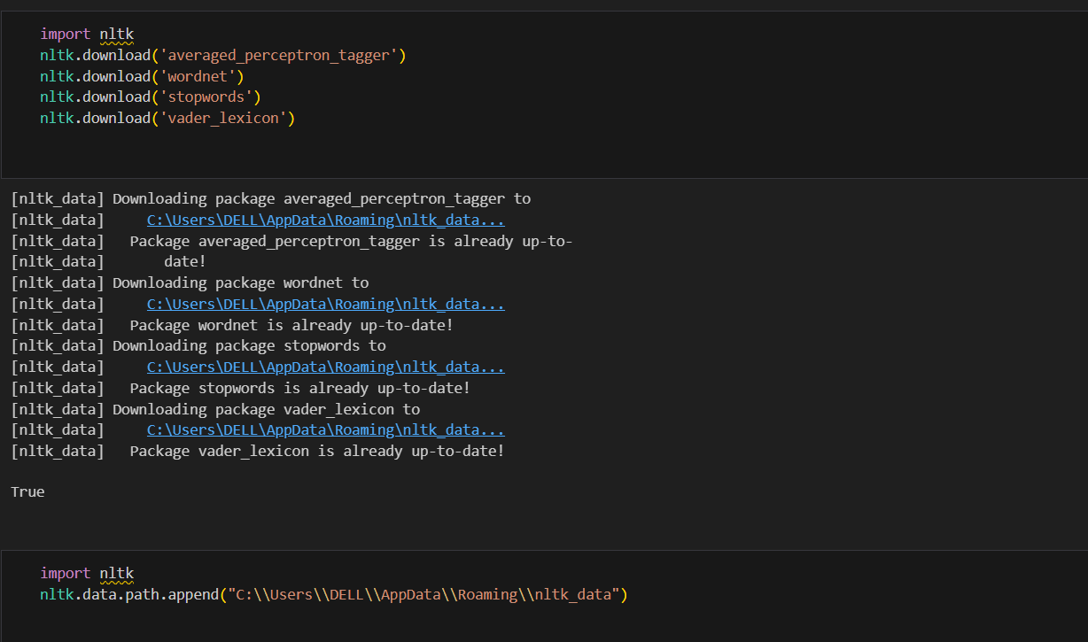
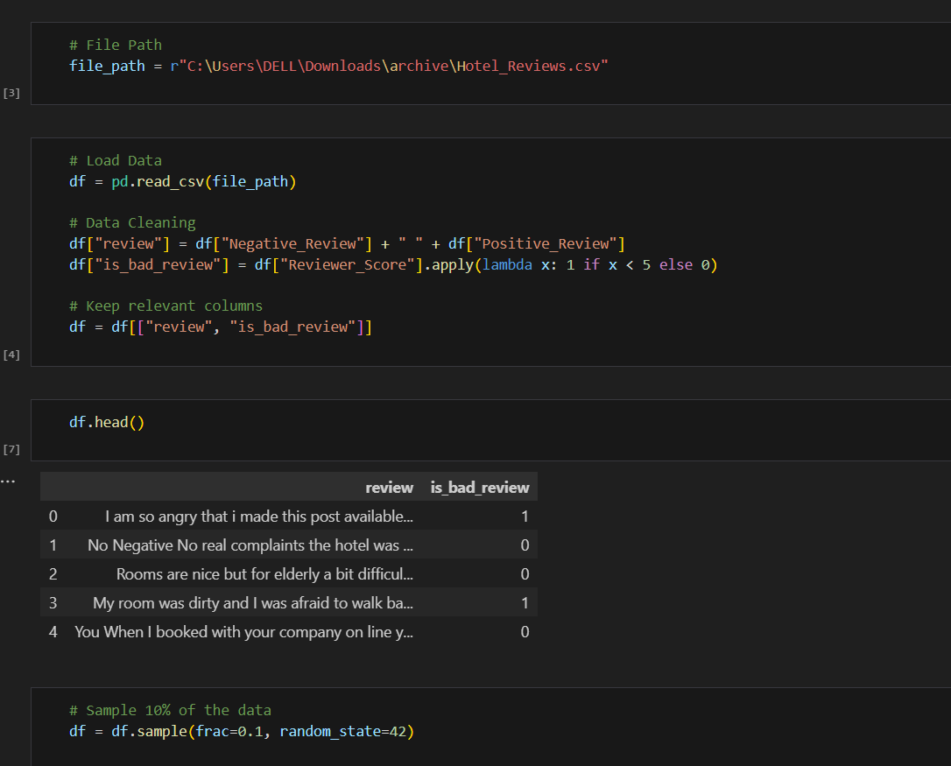
Data Preprocessing
Importing essential NLTK resources for text processing and sets the file path for the hotel reviews dataset.
Combines positive and negative reviews into a single column, labels bad reviews based on the reviewer score, and keeps only the relevant columns.

Slide 6
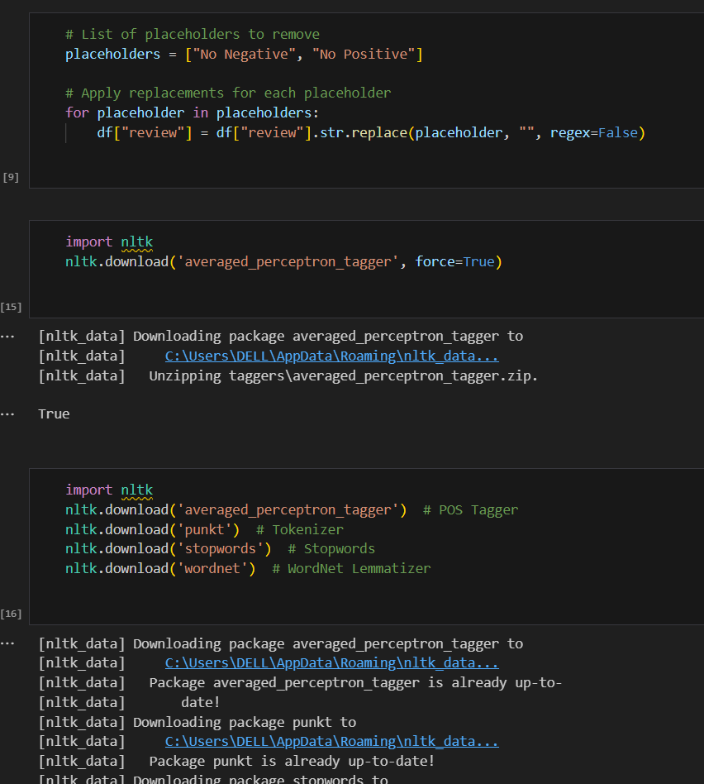
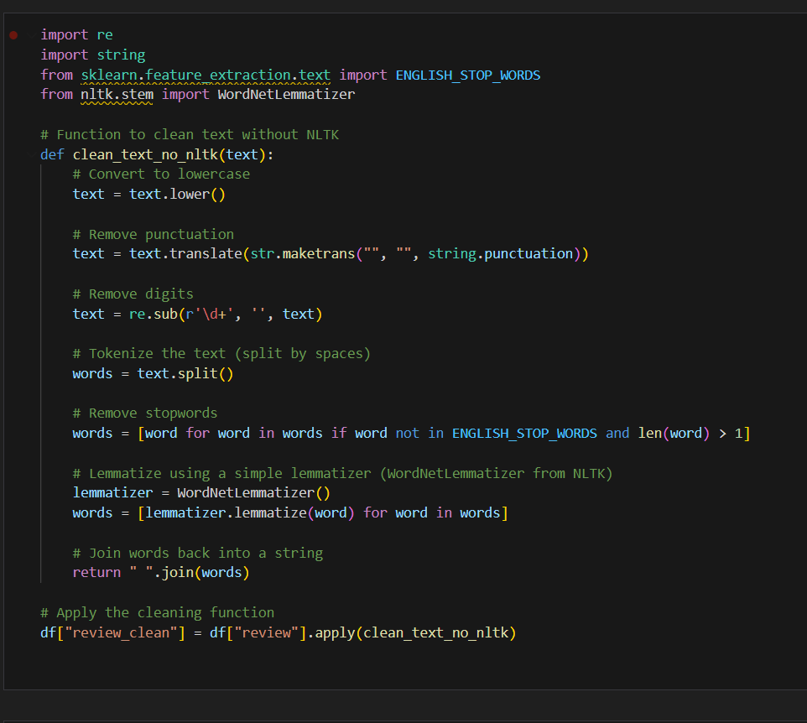
Removes placeholders like "No Negative" and "No Positive" from reviews, then applies text preprocessing by converting to lowercase, removing punctuation and digits, filtering stopwords, and lemmatizing words. The cleaned text is stored in a new column, review_clean.

Slide 7
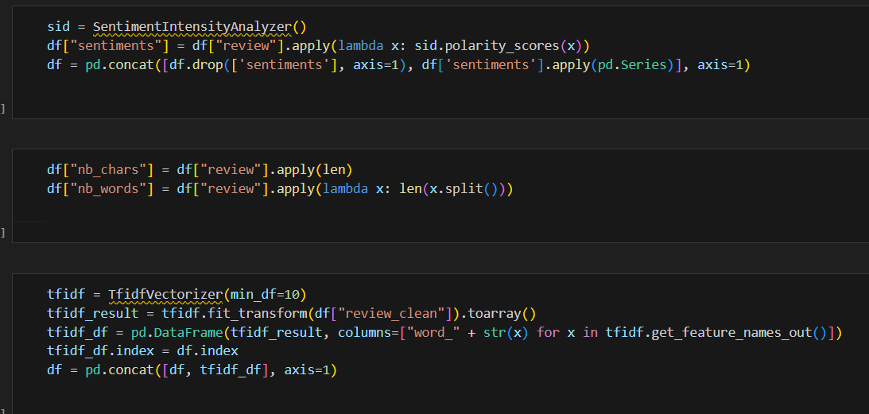
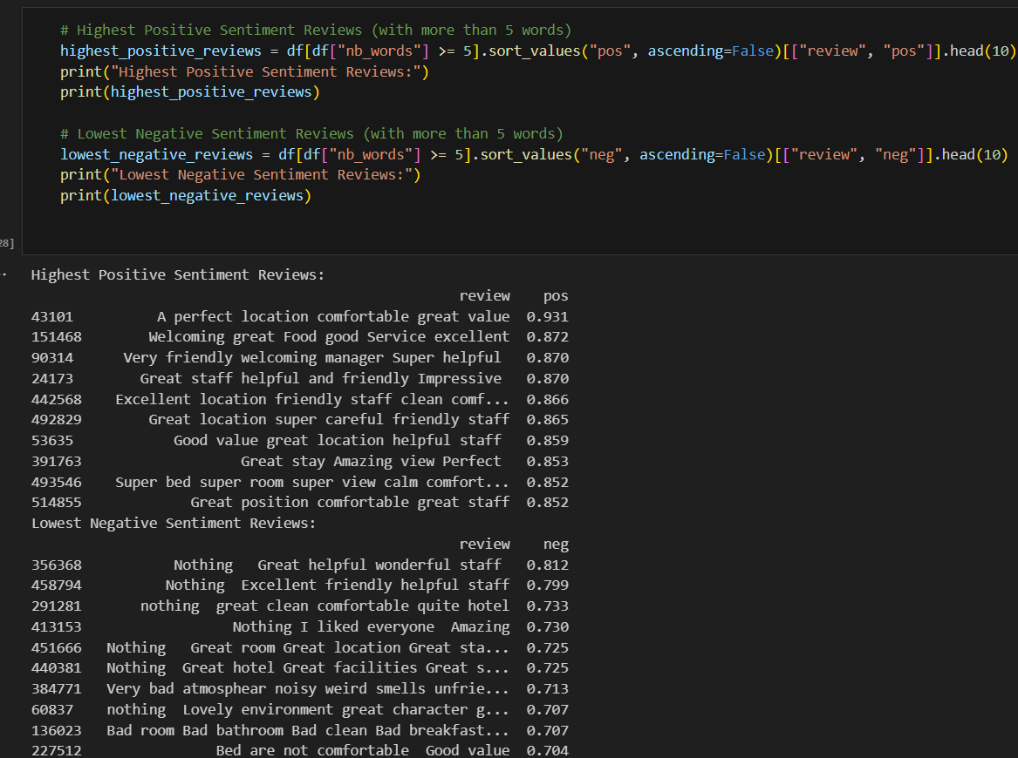
Performs sentiment analysis using VADER, extracts sentiment scores, calculates review length, and applies TF-IDF vectorization.
Identifies the top 10 highest positive and lowest negative sentiment reviews with more than five words.

Slide 8
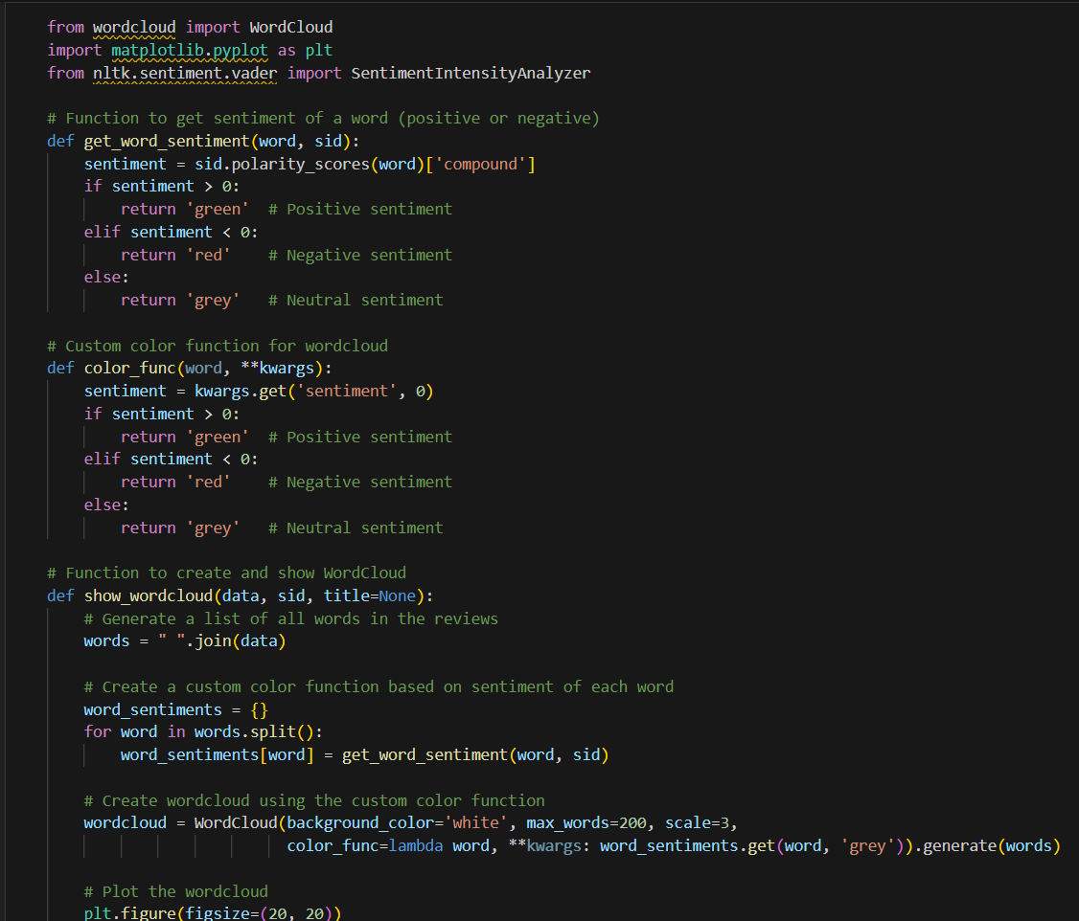
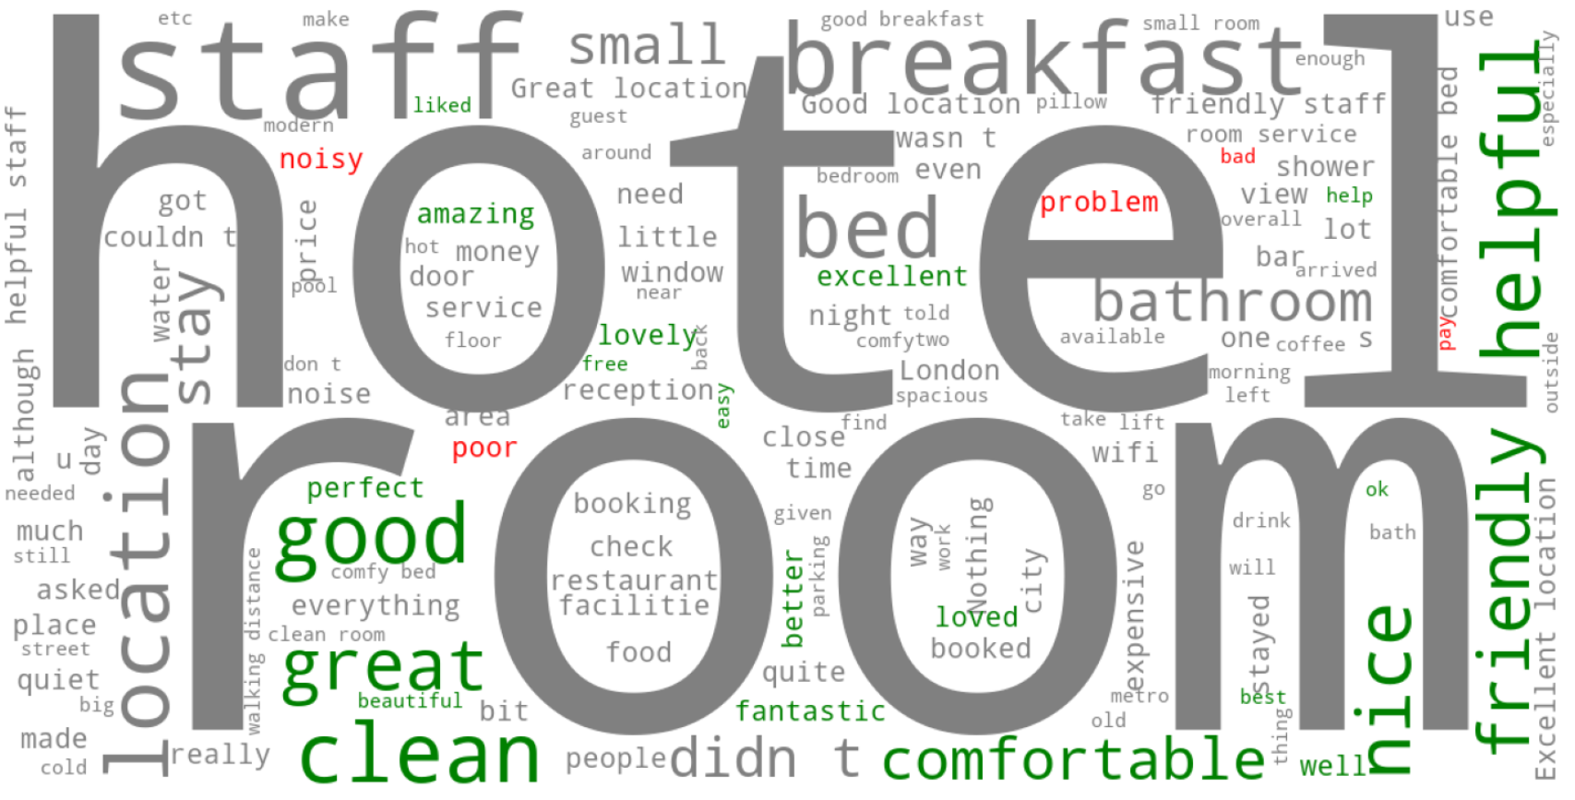
Creates a sentiment-based WordCloud from hotel reviews using VADER, where words are colored green (positive), red (negative), or grey (neutral) to visualize frequently used terms and their sentiment impact.

Slide 9
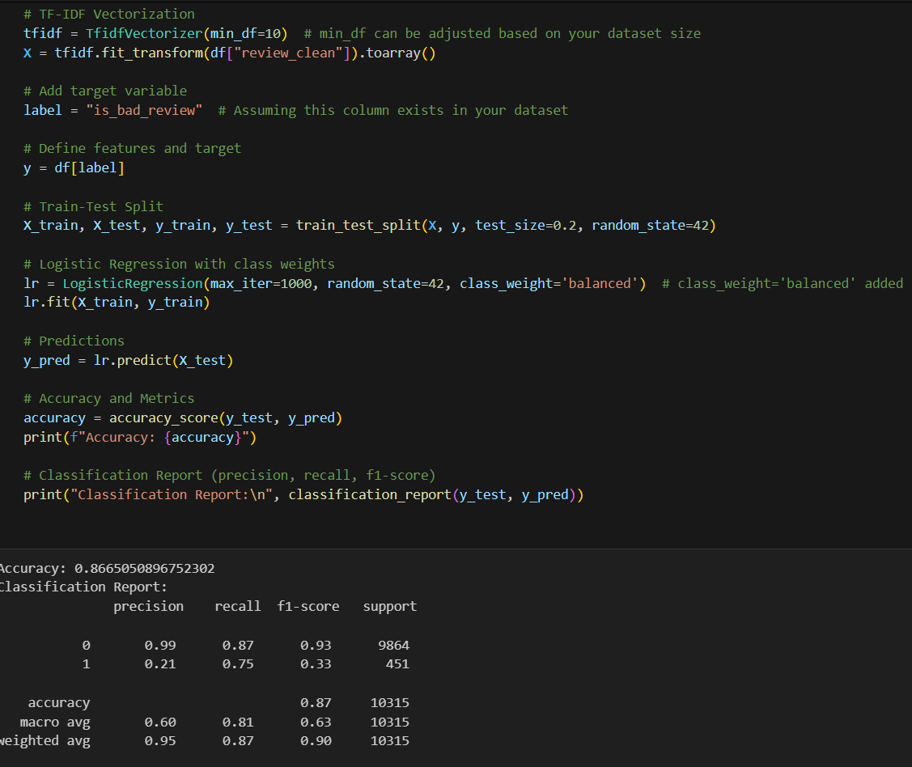
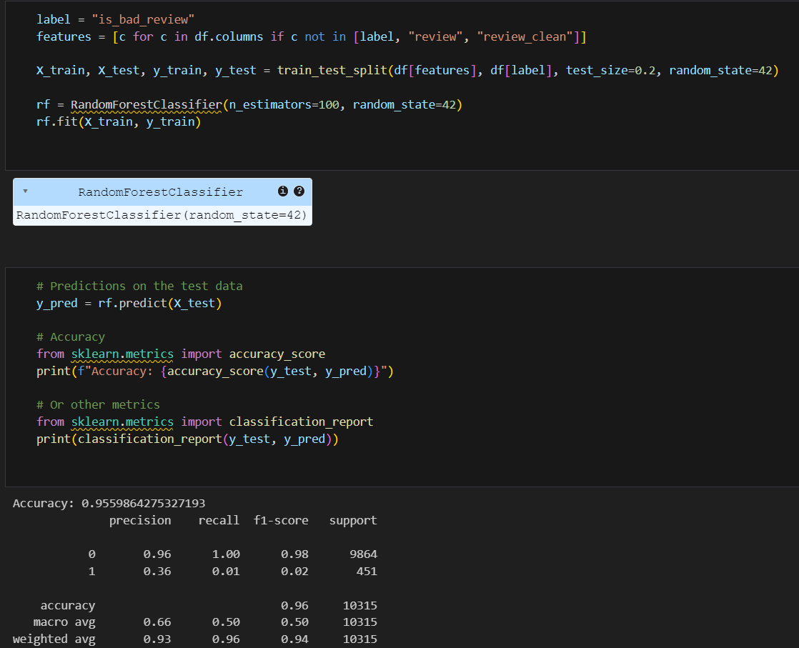
Applies TF-IDF vectorization to convert text data into numerical features, then trains and evaluates a Logistic Regression model with class balancing to predict sentiment labels.
Trains a Random Forest classifier using additional features, evaluates its accuracy, and generates a classification report for performance analysis.

Slide 10
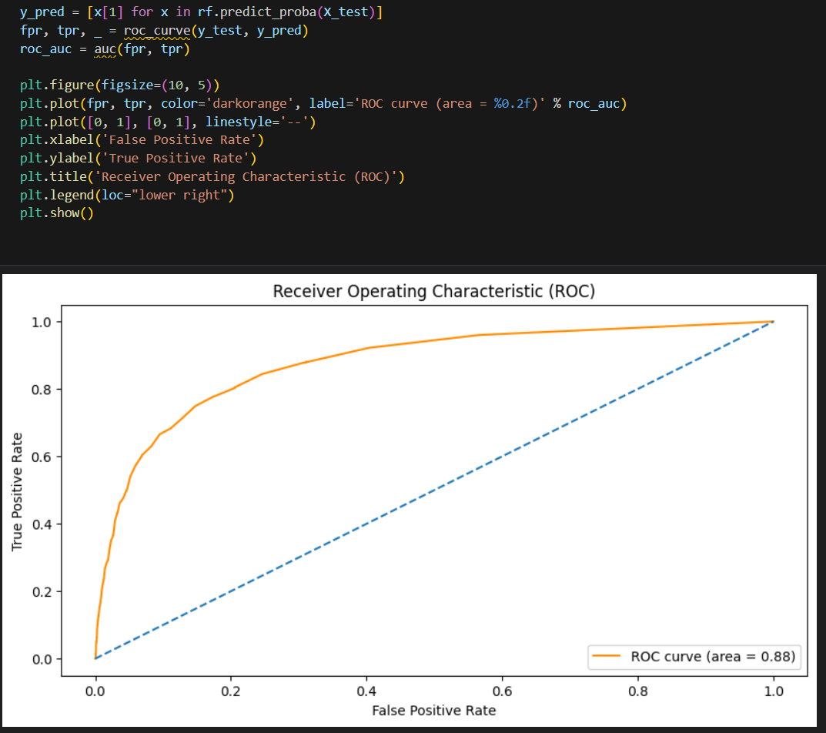
Computes ROC-AUC for the Random Forest model by predicting probabilities, calculating the false positive rate (FPR) and true positive rate (TPR), and plotting the ROC curve to assess model performance.
The AUC score of 0.88 indicates a strong classifier.

Slide 11


Slide 12
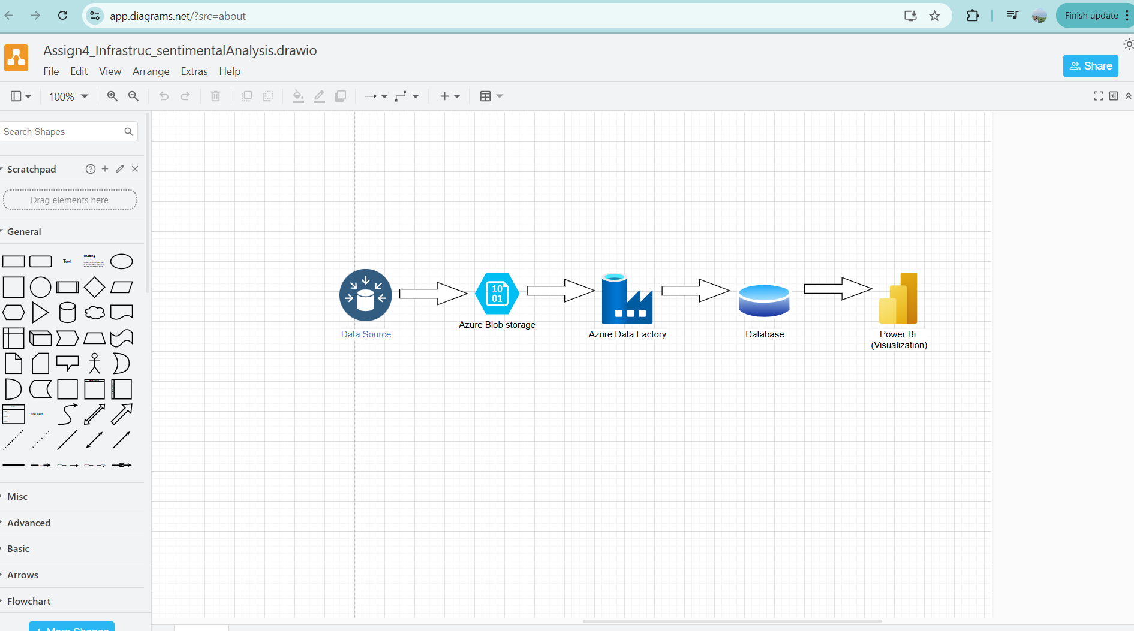
Project Architecture
Data Flow:
Data Source: Hotel reviews dataset stored in Azure Blob Storage.
Processing: Azure Data Factory for ETL (Extract, Transform, Load).
Database: Processed data stored in a SQL database.
Visualization: Power BI for interactive dashboards.

Slide 13
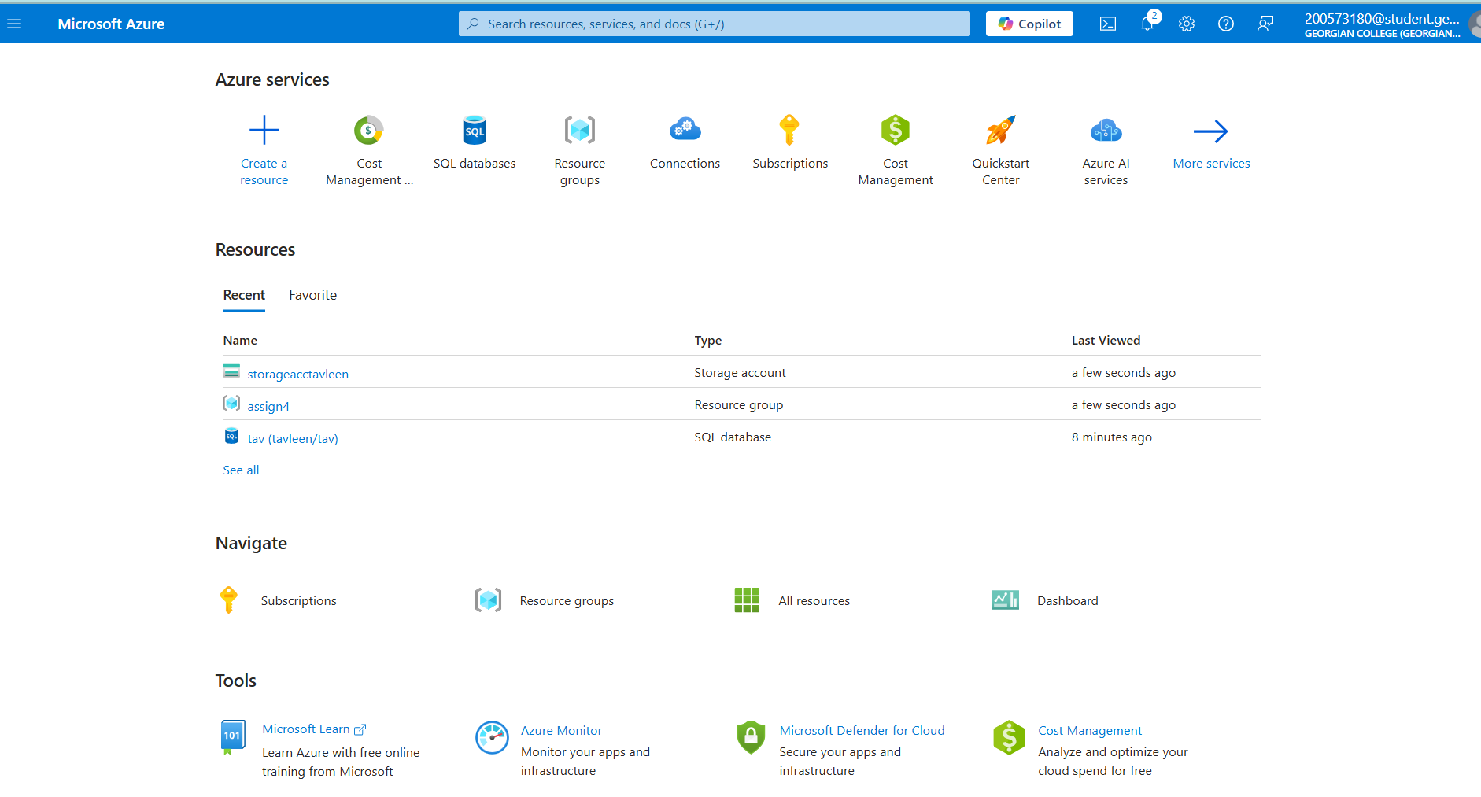
Step-2 Azure Blob Storage
Created essential resources on Microsoft Azure, including SQL Database to store and process sentiment analysis data efficiently

Slide 14
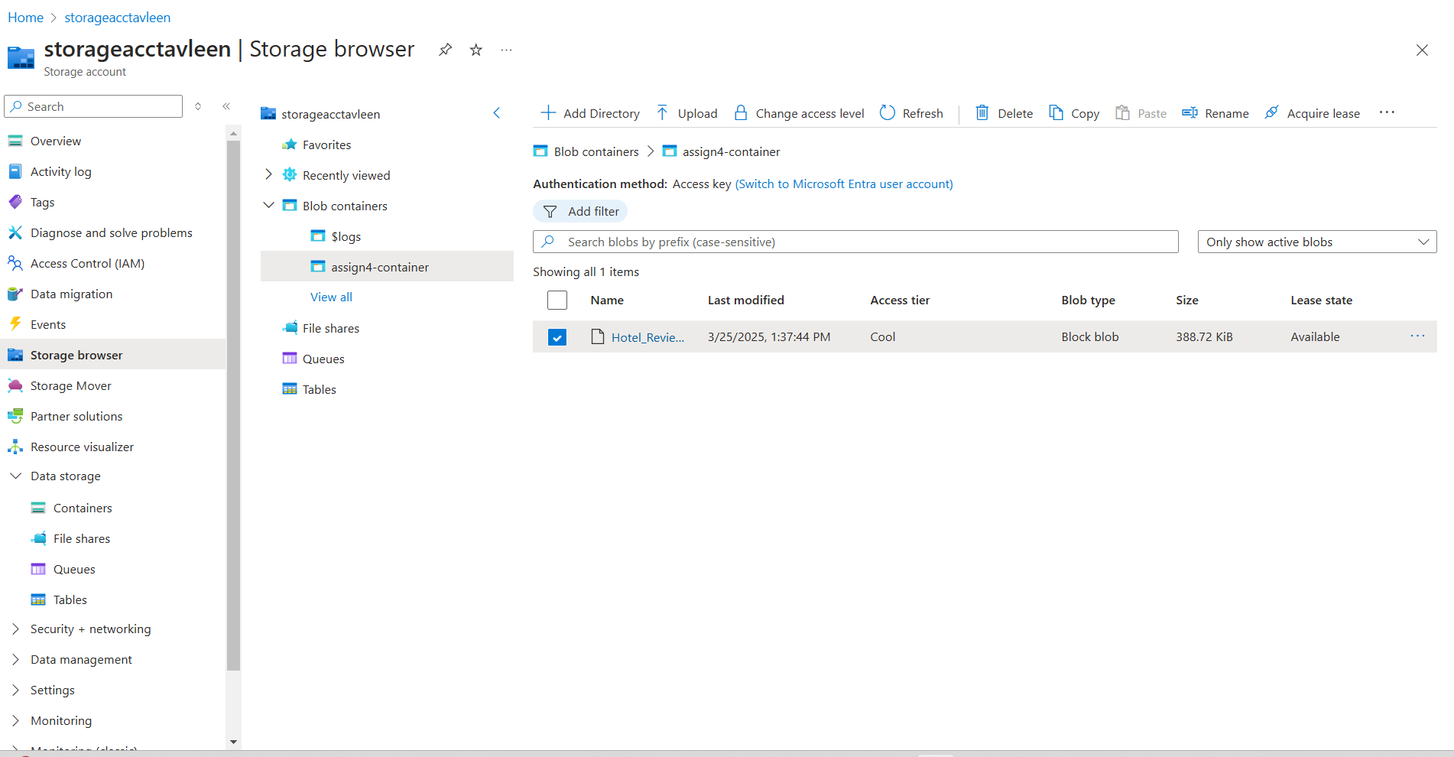
Set up an Azure Blob Storage resource and uploaded the dataset into the container.

Slide 15
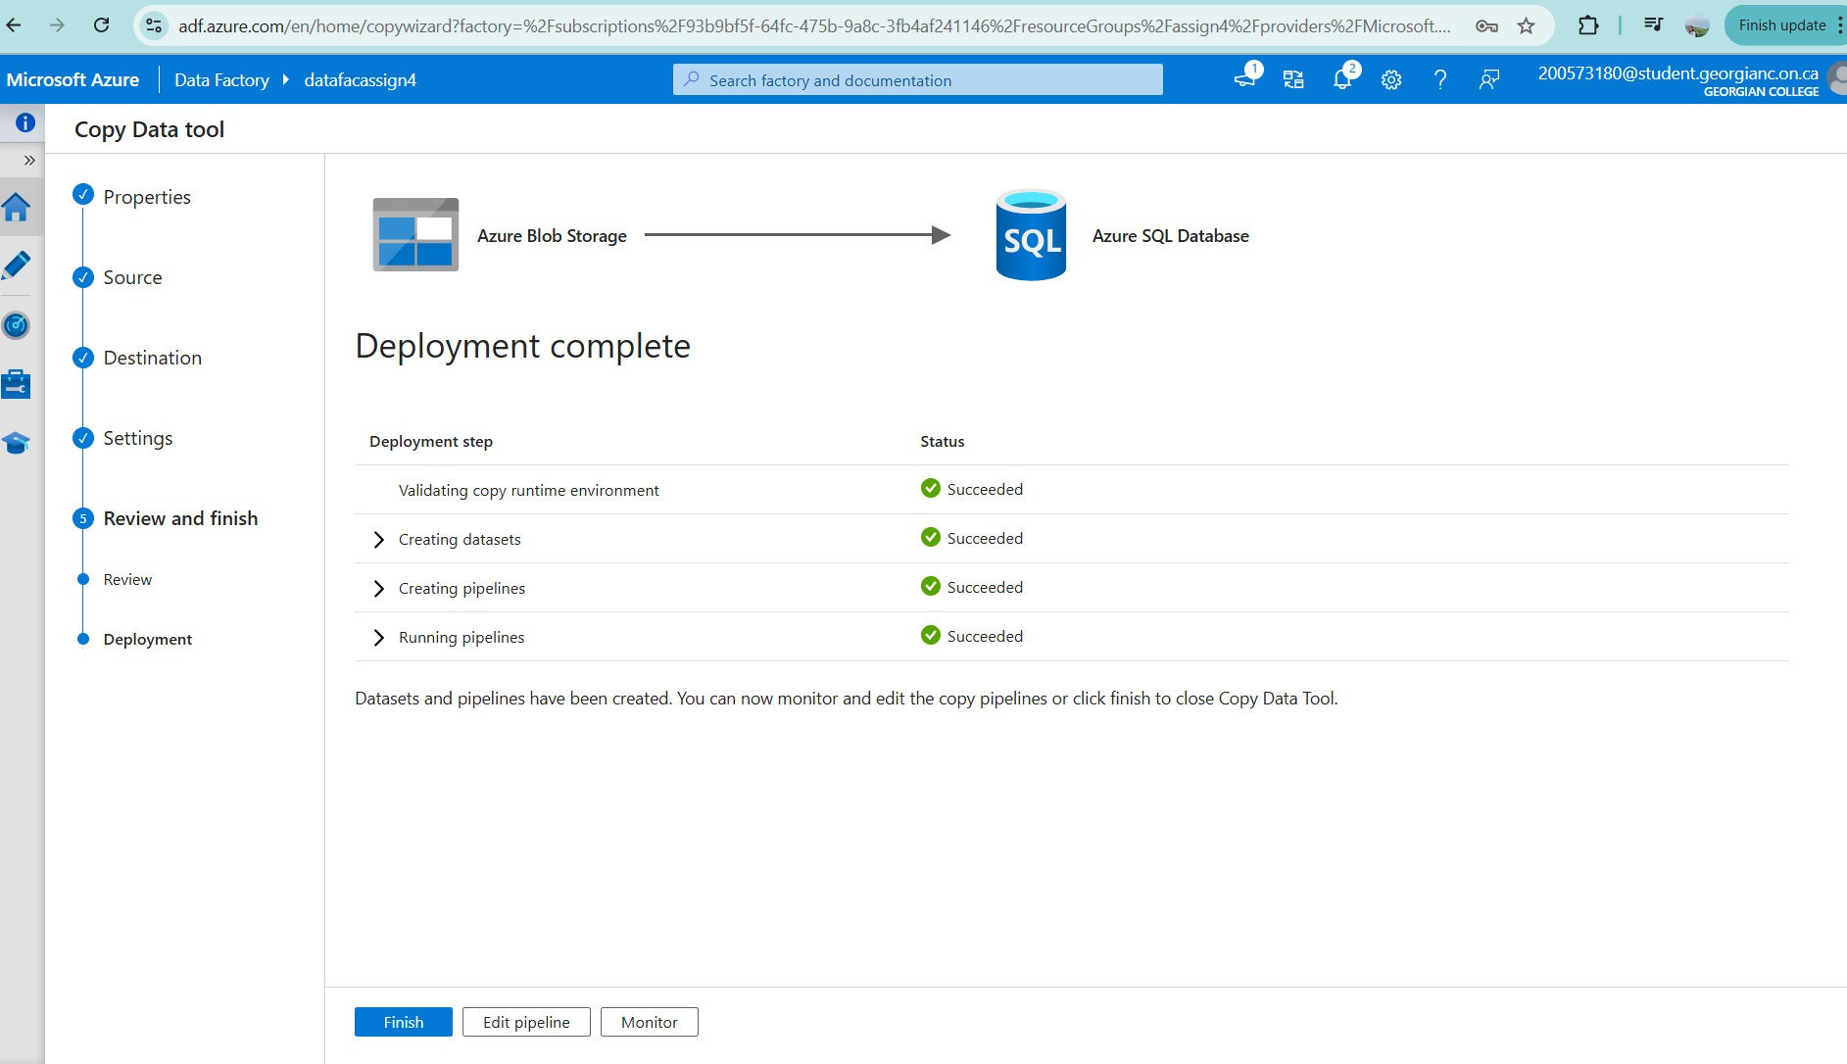
Step-3 Azure Data Factory
Created resource in Azure Data Factory
Ingested data into Azure SQL Database using built-in copy task
Established connection with Azure SQL Database
Successfully created the pipeline

Slide 16
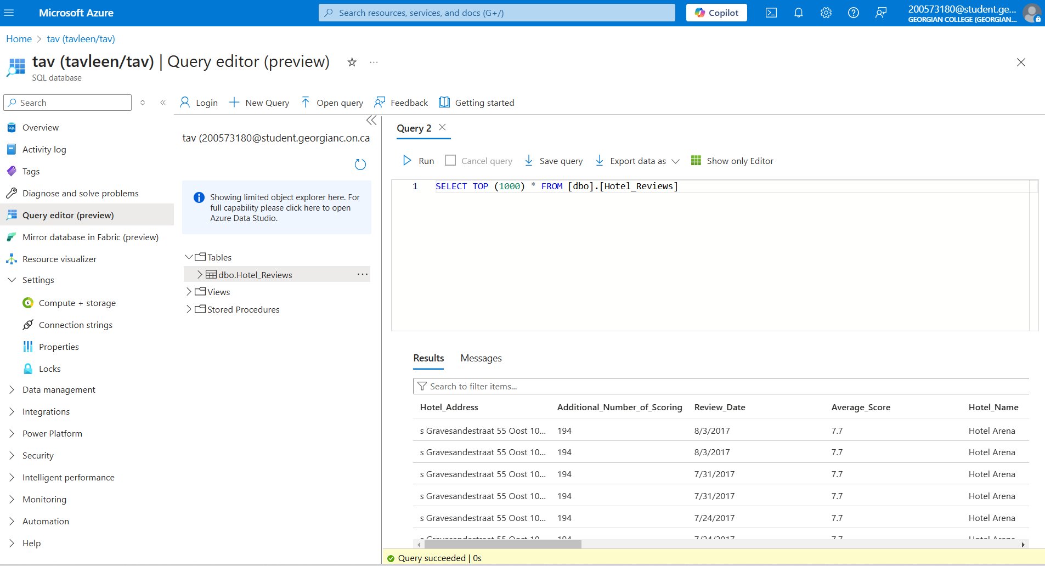
Visualized data in Microsoft Azure using SQL Database
Retrieved data by selecting the top 1000 rows for analysis

Slide 17
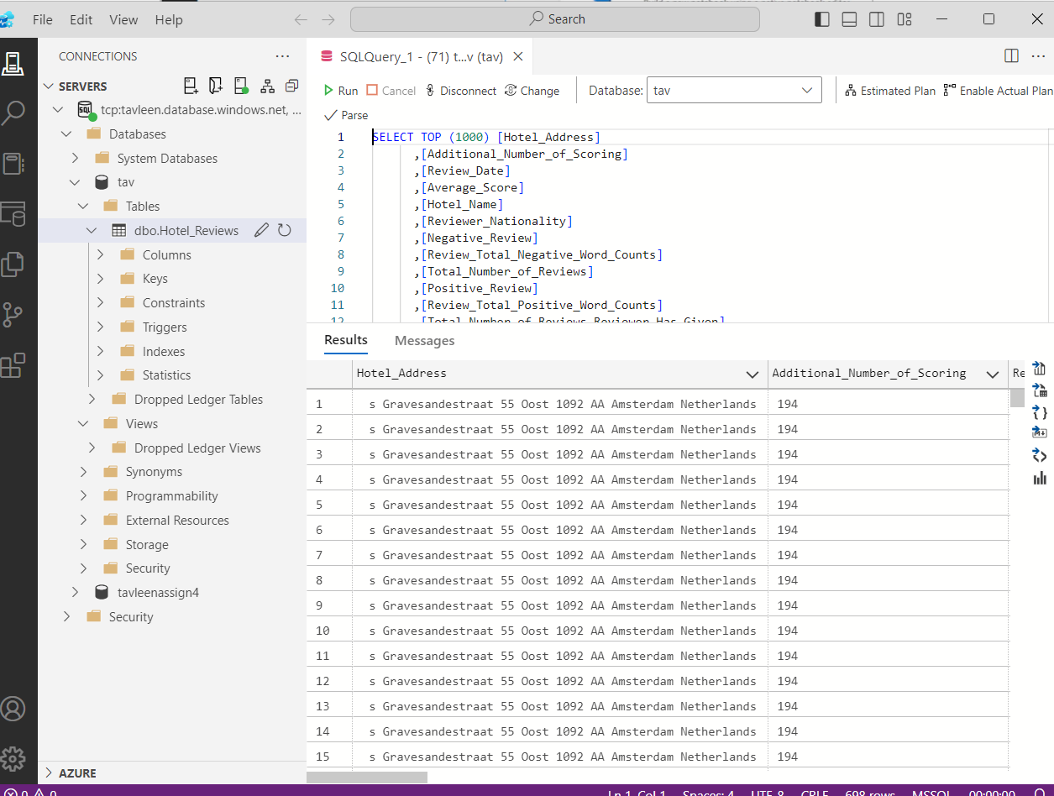
Step-4 Database
Visualized data in Azure Data Studio (SQL) through the established connection
Retrieved data by selecting the top 1000 rows for analysis

Slide 18
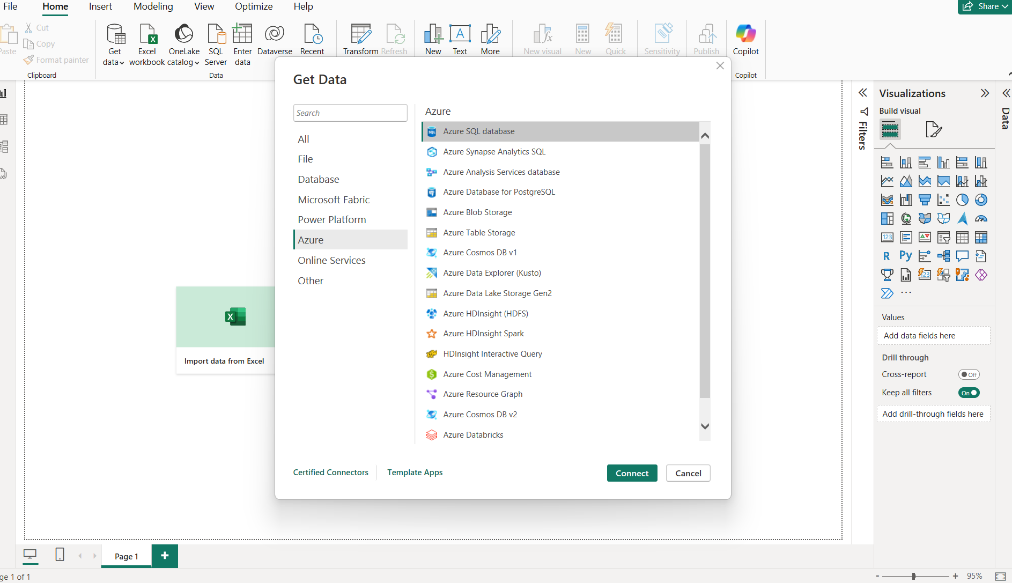
Step-5 Visualization
Visualized data for insights using Power BI
Retrieved data through the following steps: Get Data → Azure → Azure SQL Database

Slide 19
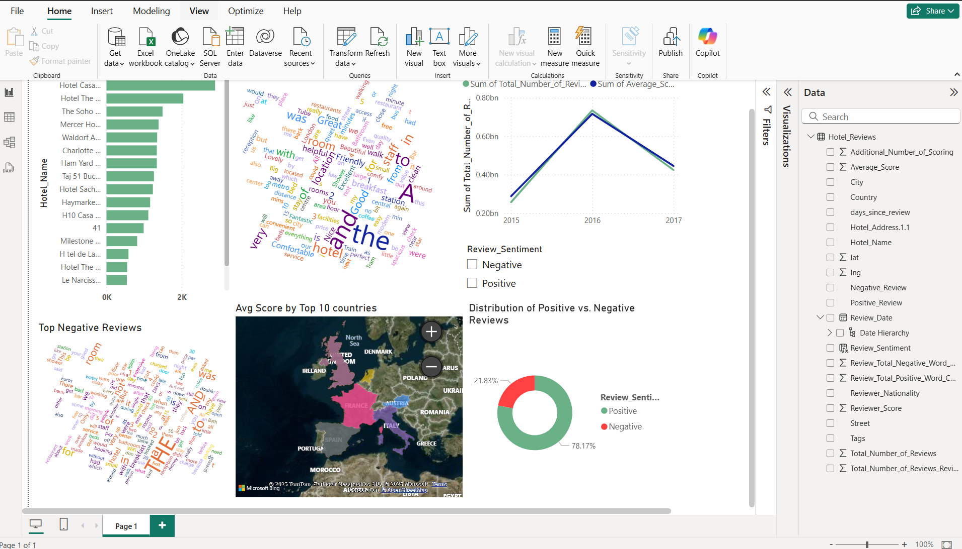
Key Insights
High-Rated Hotels: "Hotel Casa..." and "The Soho..." lead in guest satisfaction.
Negative Feedback: Common themes in negative reviews need addressing.
Positive Dominance: 78% of reviews are positive, but 22% indicate room for improvement.
Yearly Trends: Review volume & scores fluctuated (2015-2017), peaking in 2016/17.
Regional Differences: Average scores vary by country, suggesting localized service gaps.
Action: Boost low-performing hotels, address negative feedback, and track trends.

Slide 20
THANK YOU

